Slide 1
SECTION 1

Slide 2
Centralised human resources in commercial industries leads to greater productivity
Retail
Industrial
High demand and competition of space cause high land values
Residential
Land Value
Factories require good accessibility to markets and transport links
Residential buildings idealises large living space and cheap land values
Distance from Central Business District (CBD)

Slide 3
High accessibility to the market
High accessibility to labour
Decreasing housing density
Increasing quality of life
Decreasing land values
Increasing transport costs
Land Value
Lack of factories increases quality of life, forming middle-class residential
1
CBD
2
Factory zone
3
Working- class residential
4
Middle-class residential
Distance from CBD

Slide 4
1
Central Business District (CBD)
2
Factory zone
1
2
3
4
5
3
Working-class residential zone
4
Middle-class residential zone
5
Commuter zone

Slide 5



Slide 6
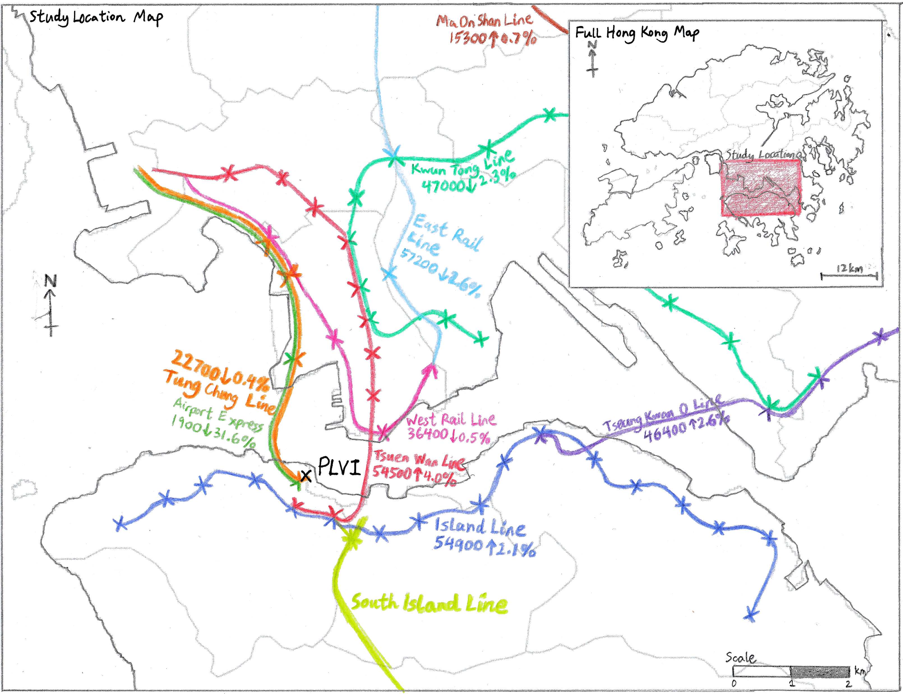
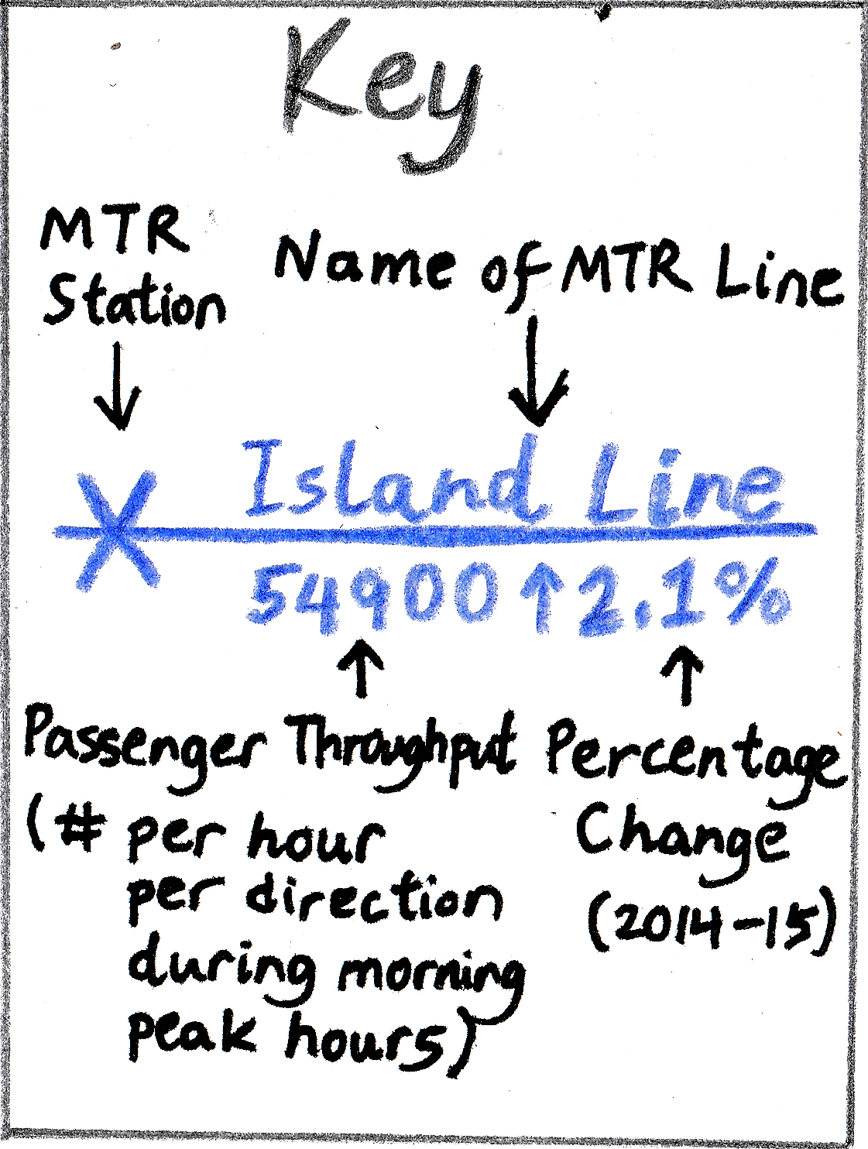

Slide 7
High accessibility to market and labour
Steep drop due to distinct difference in land use
Building Height
Central Business District
Major transport road directed towards the CBD
Inner City
Low-class residential
Middle-class residential
Desires to keep a distance from poor, low-class residential areas
High-class residential

Slide 8
Primary Central Business District
Secondary peak in land value
Building Height
Secondary Central Business District
Inner City
Desires be far away from pollution near industrial zones
Industrial Zone
Low-class residential
Middle-class residential
Accessible to smaller “nodes”
Zones specialised for single land use to maximise affordability
High-class residential

Slide 9
Local opposition deters urban renewal projects
Building Height
Average building height is low
Building Height
Building height may be lower than expected.
Technological Advancements and urban development
Distance
Distance
Low amount of population distributed across large area
Old buildings are demolished, replaced with taller buildings

Slide 10
SECTION 2

Slide 12
Decreasing scale
Step 1
Step 2
Step 3
Stratified sampling
Systematic sampling
Systematic sampling
N
Relative to street
For each transect
200m
200m
200m
For each interval
25m
W
E
PLVI
S
Four transects along the cardinal directions centred at the PLVI
Selecting buildings based on the four intercardinal directions
Regular 200m intervals along the transect

Slide 13
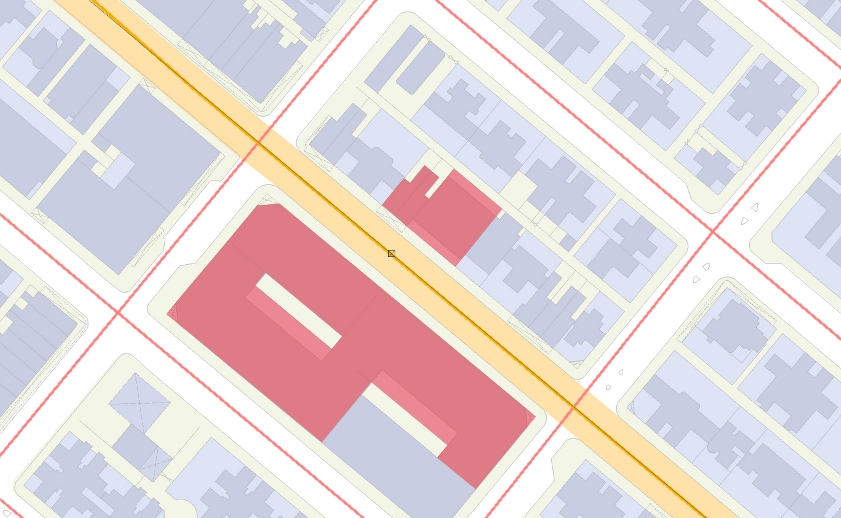
N
25m radius circle centred at the interval
Circle heading aligned with street, away from PLVI
A 10° deviation from the arrows is allowed
N24NE: 136-138 Castle Peak Road
N24NW: Price Theatre
N24SE: Wai Lee Commercial Building
Four arrows heading in intercardinal directions
Legend
Buildings in first contact with the arrow is selected
Selected Building
Podium
Tower
Road
N24SW: Hung Yu Mansion Block B
Street
25m

Slide 14
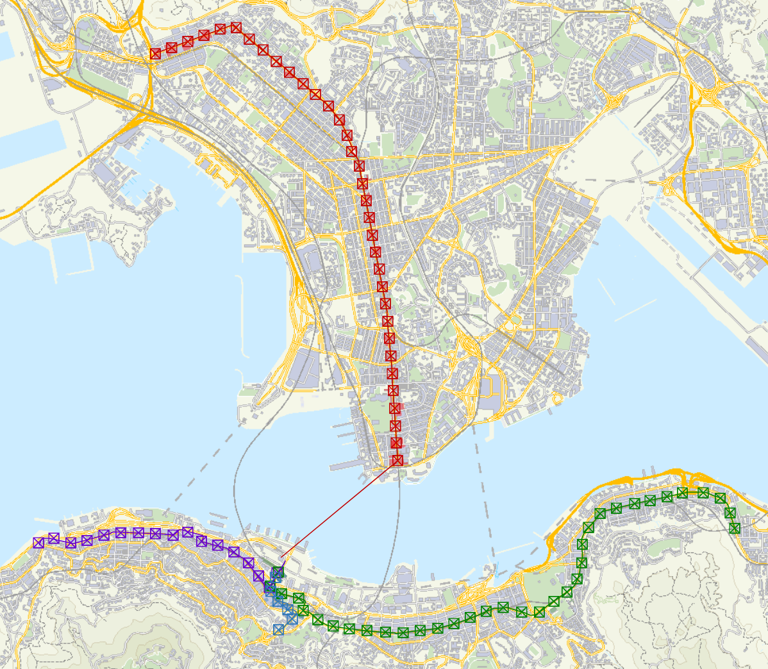




Legend
North:
Transect
N
Interval
Selected Building
East:
Major roads running along the N,E,S,W direction
Transect
Interval
Selected Building
South:
Transect
Interval
Selected Building
No buildings in the NW direction
West:
Transect
Interval
PLVI
1km

Slide 15
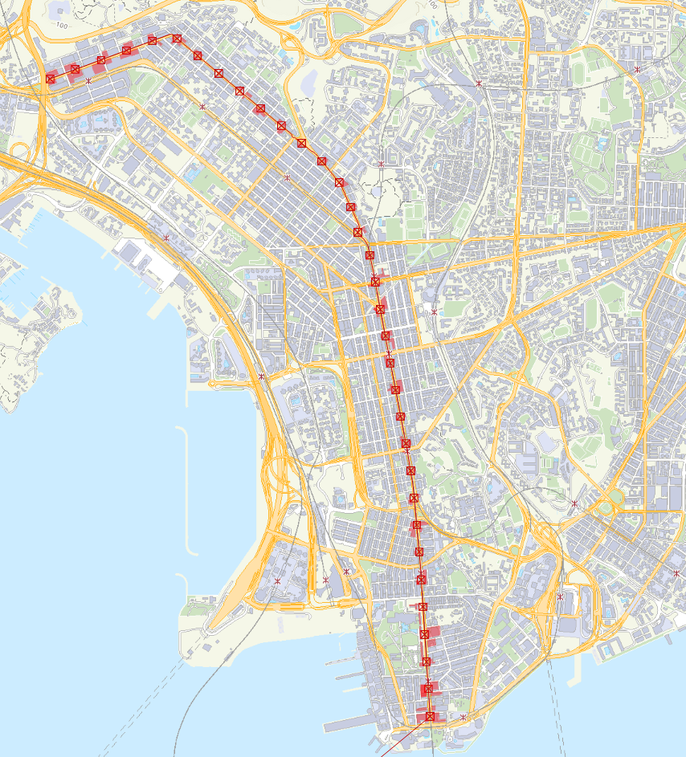
Single-way four-lane road, 21.1m wide
Legend
Transect
Interval
Selected Building
Transect moved upwards to avoid parks and government buildings
Runs along a major road with multiple MTR stations
Dual-way three-lane road, 21.5m wide
N
Towards PLVI
500m

Slide 16
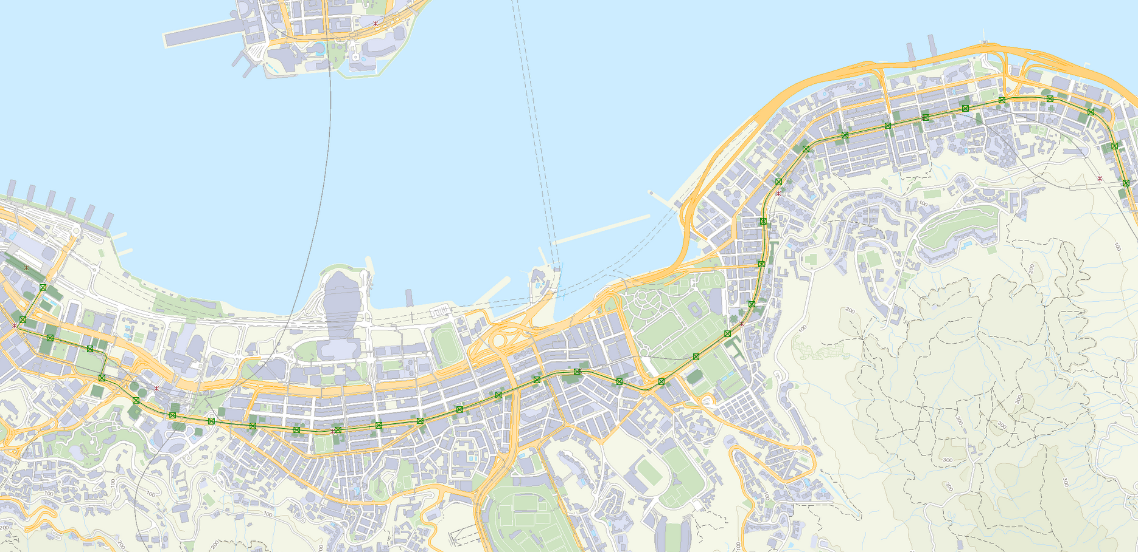
N
500m
Major road with multiple MTR and tram stations
Dual-way 2/3-lane road, 23.2m wide
PLVI
Legend
Dual-way three-lane road, 23.2m wide
Transect
Interval
Selected Building

Slide 17
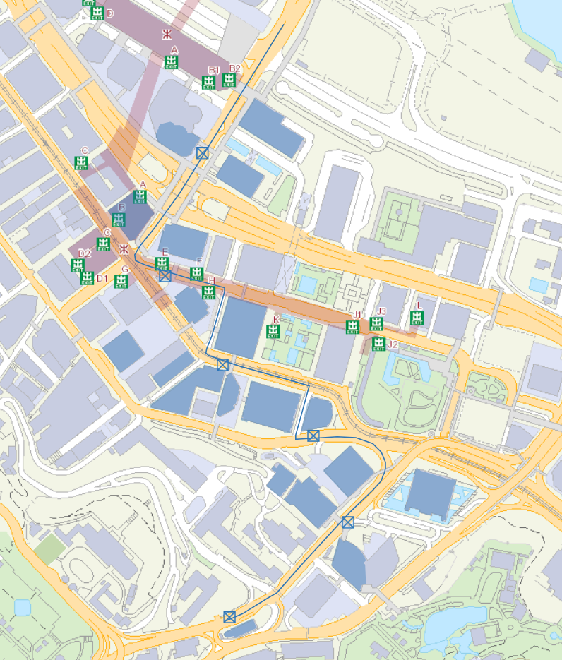
Legend
Dual-way two-lane road, 20.0m wide
PLVI
Transect
Interval
Selected Building
100m
N
Dual-way two-lane road, 9.9m wide
Dual-way three-lane road, 23.2m wide
Avoiding parks
Single-way four-lane road, 12.8m wide

Slide 18
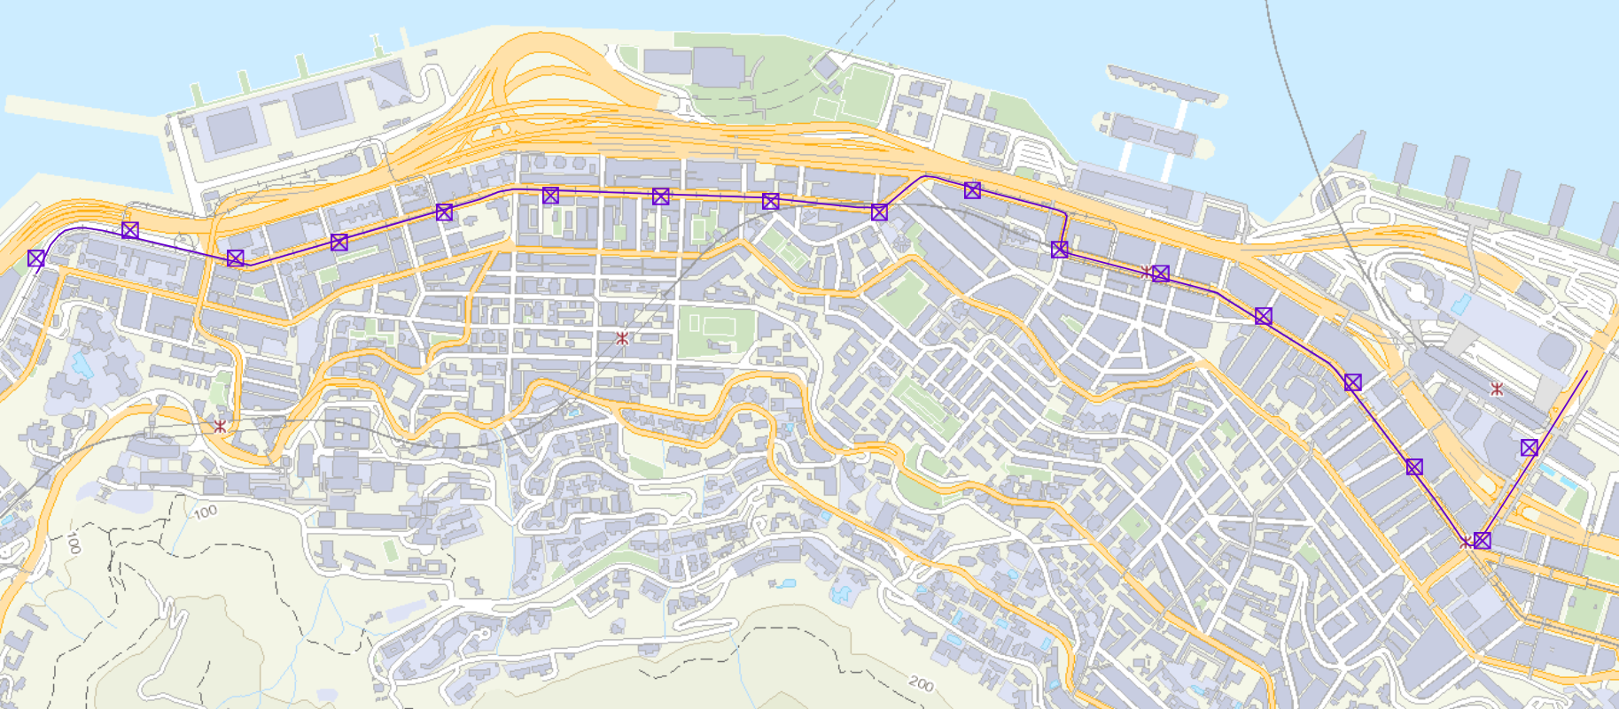
N
Avoiding seaside where there are no buildings
Legend
Transect
Interval
Avoiding parks
Dual-way 2-lane road, 16.5m wide
Single-way 1-lane road, 12.9m wide
Dual-way 2/3-lane road, 19.4m wide
PLVI
Dual-way 2-lane road, 16.3m wide
200m

Slide 19

Exclusion (Table 1)
N1NE
Outlier
N1SE
N1NE
1
N1SE
Std. Dev of N1SE, N1SW, N1NW
Mean of N1SW, N1NW
N1SW
N1NW
T-value
2.4.1
Standard Deviation Outlier Test
2.4.2
Spearman’s Rank Correlation Coefficient
2.4.2
Spearman’s Rank Correlation Coefficient
2.4.3
T-test
Rejection/acceptance of null hypothesis
R-value
N2NE
Std. Dev of N2NE, N2SE
Mean of N2NE, N2SE
2
N2SE
N2SW
N2NW
N2SW
Exclusion (Table 1)
N2NW
$$⋮$$

Slide 20



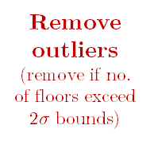

Individual Transect Calculations
Code
#no of floors
N1NE
0
N1NE^
0
N1
N1SE
20
N1SE
20
N1SE
20
N1SW
25
N1SW
25
N1SW
25
Code
Mean
xRank
yRank
d²
Remove errors
(no buildings^, construction sites etc.)
Remove outliers
(remove if no. of floors exceed $2σ$ bounds)
N1
22.5
1
1
0
N1NW
75
N1NW
75
N1NW
75
N2
33.5
2
2
0
N2NE
0
N2NE^
0
SRCC
$$⋮$$
N2SE
21
N2SE
21
N2SE
21
Data size (N10)
N2
R-value (N11)
N2SW
22
N2SW
22
N2SW
22
N2NW
24
N2NW
24
N2NW
24
T-value (N12)
For all
Critical t-value (N13)
$$⋮$$
$$⋮$$
$$⋮$$
For all
For all
Reject H₀? (N14)
Raw Mean (N2)
No Error Mean (N4)
Excluded Mean (N6)
Raw Std. Dev. (N3)
No Error Std. Dev. (N5)
Excluded Std. Dev. (N7)
Generate graph with all raw data
Generate graph with errors and outliers removed

Slide 21

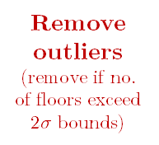




Combined transect calculations
Overall process is pretty much the same, except data are all initially concatenated together and are grouped by distance.
Code
#no of floors
N1NE
0
N1NE^
0
N1NE
0
N1SE
20
N1SE
20
N1SE
20
N1
N1SE
20
Combine data from all transects
N1SW
25
N1SW
25
N1SW
25
N1SW
25
N1NW
75
N1NW
75
N1NW
75
N1NW
75
E1NE
0
E1NE^
0
E1SE
20
Remove errors
(duplicate buildings*, no buildings^, construction sites etc.)
E1SE*
20
N2NE
0
E1SW
24
E1SW
24
Remove outliers
(remove if no. of floors exceed $2σ$ bounds)
E1SW
24
N2
N2SE
21
E1NW
69
E1NW
69
E1NW
69
N2SW
22
Data size (N10)
N2NW
24
N2NE
0
N2NE
0
SRCC
R-value (N11)
$$⋮$$
N2SE
21
N2SE
21
N2SE
21
T-value (N12)
N2SW
22
N2SW
22
N2SW
22
Critical t-value (N13)
Code
#no of floors
Reject H₀? (N14)
E1NE
0
N2NW
24
N2NW
24
N2NW
24
E1SE
20
E2NE
0
E2NE
0
E1
E2SE
21
E2SE*
21
E1SW
24
E1NW
69
E2SW
23
E2SW
23
E2SW
23
E2NW
23
E2NW
23
E2NW
23
group by distance from PLVI
$$⋮$$
$$⋮$$
E2NE
0
$$⋮$$
For all
For all
For all
E2
E2SE
21
Raw Mean (N2)
No Error Mean (N4)
Excluded Mean (N6)
E2SW
23
Raw Std. Dev. (N3)
No Error Std. Dev. (N5)
Excluded Std. Dev. (N7)
E2NW
23
*there are some cases where the same building is used across several transects, so such duplicates will be removed.
$$⋮$$

Slide 22
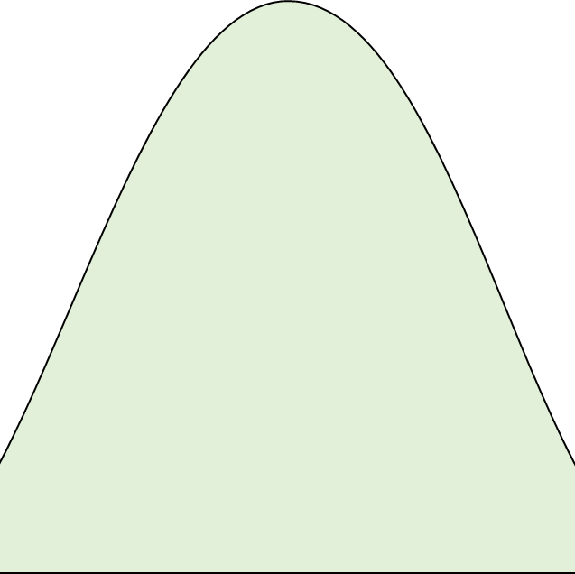
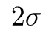
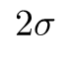
Normal distribution curve
Accept value
Probability Density
Represents 95.4% probability, for values within 2 standard deviations
Represents 4.6% probability, for values beyond 2 standard deviations
Reject value
$$2σ$$
$$2σ$$
Number of storeys
Mean

Slide 23

Rank by increasing order
In case of same ranks, take its average
Distance from PLVI, x
Rank of x, r(x)
Storeys, y
Rank of y, r(y)
Difference, d
d ²
0
0
69
5
-5
25
200
1
58
3,4 3.5
-2.5
6.25
400
2
58
3,4 3.5
-1.5
2.25
600
3
47
2
1
1
800
4
36
1
3
9
Sum, Σd ²
43.5
Perfect negative correlation
$−$1
R
1
Perfect positive correlation

Slide 24
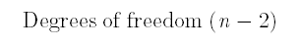
Critical t-value
Degrees of freedom (n $−$ 2)

Slide 25
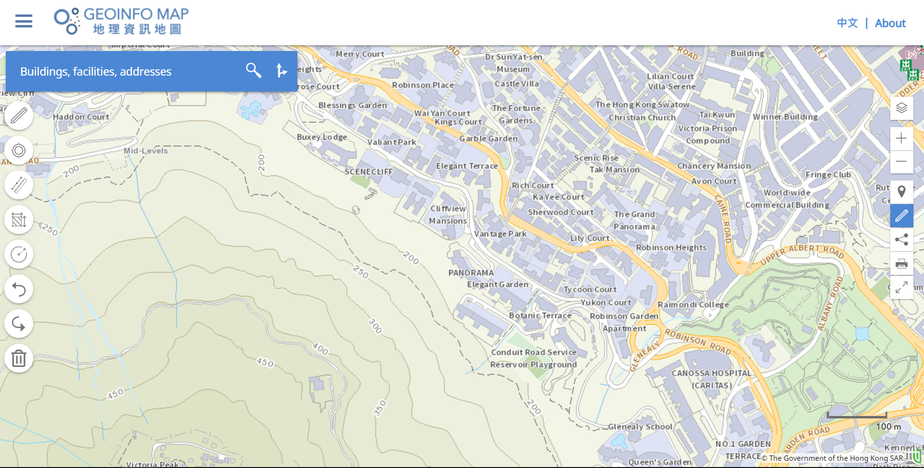
Highly accurate and official data from the government
Manual
Automated
ArcGIS Geocoding Service provided by the Lands Department
Internet
Transects are drawn precisely on GeoInfo Map
Google Sheets for further processing
Google MyMaps for collaborative visualisation
Transect is downloaded in the form of a KML document
CSV
KML
Python recursively splits transect into 200m intervals
Python queries a list of surrounding buildings at each interval
Python outputs list of buildings in CSV and KML formats
User select 4 buildings with visual guidance
Computer
Human error and selection bias eliminated

Slide 26
SECTION 3

Slide 27
Plot of Number of Storeys (raw) against Distance From PLVI along the North Transect
Key
Data point
Number of Storeys (raw)
Linear trendline
Distance from PLVI (m)
Plot of Mean Number of Storeys (errors and outliers removed) against Distance From PLVI along the North Transect
Key
Mean number of storeys (errors and outliers removed)
Data point
Linear trendline
Standard Deviation
Distance from PLVI (m)

Slide 28
Plot of Number of Storeys (raw) against Distance From PLVI along the East Transect
Key
Data point
Number of Storeys (raw)
Linear trendline
Distance from PLVI (m)
Plot of Mean Number of Storeys (errors and outliers removed) against Distance From PLVI along the East Transect
Key
Mean number of storeys (errors and outliers removed)
Data point
Linear trendline
Standard Deviation
Distance from PLVI (m)

Slide 29
Plot of Number of Storeys (raw) against Distance From PLVI along the South Transect
Key
Data point
Number of Storeys (raw)
Linear trendline
Distance from PLVI (m)
Plot of Mean Number of Storeys (errors and outliers removed) against Distance From PLVI along the South Transect
Key
Mean number of storeys (errors and outliers removed)
Data point
Linear trendline
Standard Deviation
Distance from PLVI (m)

Slide 30
Plot of Number of Storeys (raw) against Distance From PLVI along the West Transect
Key
Data point
Number of Storeys (raw)
Linear trendline
Distance from PLVI (m)
Plot of Mean Number of Storeys (errors and outliers removed) against Distance From PLVI along the West Transect
Key
Mean number of storeys (errors and outliers removed)
Data point
Linear trendline
Standard Deviation
Distance from PLVI (m)

Slide 31
Plot of Number of Storeys (raw) against Distance From PLVI along the Combined Transects
Key
Data point
Number of Storeys (raw)
Linear trendline
Distance from PLVI (m)
Plot of Mean Number of Storeys (errors and outliers removed) against Distance From PLVI along the Combined Transects
Key
Mean number of storeys (errors and outliers removed)
Data point
Linear trendline
Standard Deviation
Distance from PLVI (m)

Slide 32
SECTION 4

Slide 33
Indicates moderate negative correlation
t-value lower than critical t-value, hence null hypothesis rejected

Slide 34
Indicates moderate negative correlation
t-value lower than critical t-value, hence null hypothesis rejected

Slide 35
Indicates weak negative correlation
t-value lower than critical t-value, hence null hypothesis accepted

Slide 36
Indicates weak negative correlation
t-value lower than critical t-value, hence null hypothesis accepted

Slide 37
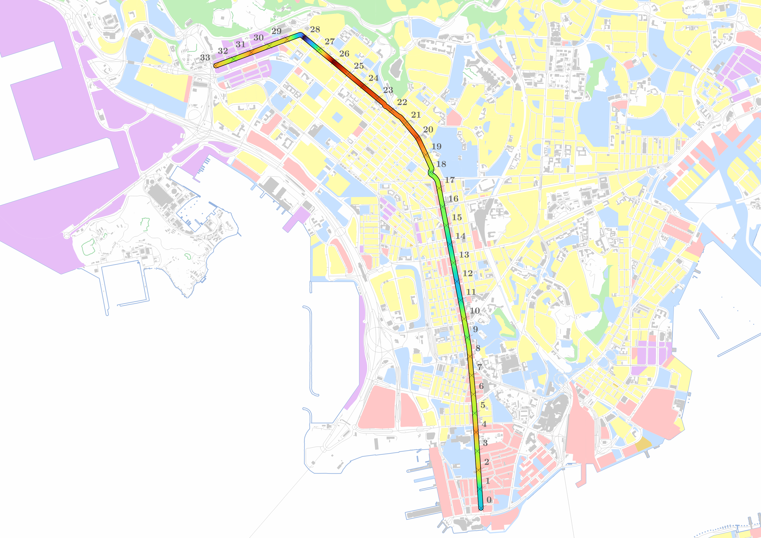

Sham Shui Po: old residential district
Cheung Sha Wan: industrial
Mong Kok: major shopping area
Legend
5
Yau Ma Tei: old residential district
Mean number of storeys along transect
Roads
Shoreline
30
Buildings
Land use
Kowloon Park: recreational area
Commercial use
Green Belt
N
Mixed commercial and residential use
Recreational use
Residential use
Industrial use
500m

Slide 38
Plot of Mean Number of Storeys (with errors and outliers removed) and Building Height Restriction within a 200m Buffer, against Distance from PLVI, along the North Transect
Key
5
Mean number of storeys (with errors and outliers removed)
3
4
Building Height restriction for buildings within a 20m buffer
Number of storeys
2
Commercial use
Mixed commercial and residential use
1
Residential use
Recreational use
Distance from PLVI (m)
Industrial use

Slide 39
Plot of Mean Number of Storeys (with errors and outliers removed) and Kernel Probability Density of Accessing Transportation Nodes, against the Distance from PLVI, along the North Transect
1
Key
Mean number of storeys (with errors and outliers removed)
2
Number of storeys
Kernel Probability Density (per m)
Kernel Probability Density of accessing a bus stop within 200m of the location
Kernel Probability Density of accessing one MTR exit within 500m
Distance from PLVI (m)

Slide 40
Plot of Mean Number of Storeys (with errors and outliers removed) and Median Household Monthly Income, against the Distance from PLVI, along the North Transect
46410
51250
Key
1
2
Mean number of storeys (with errors and outliers removed)
Number of storeys
Median Household Monthly Income (HKD)
Median household monthly income
Distance from PLVI (m)

Slide 41
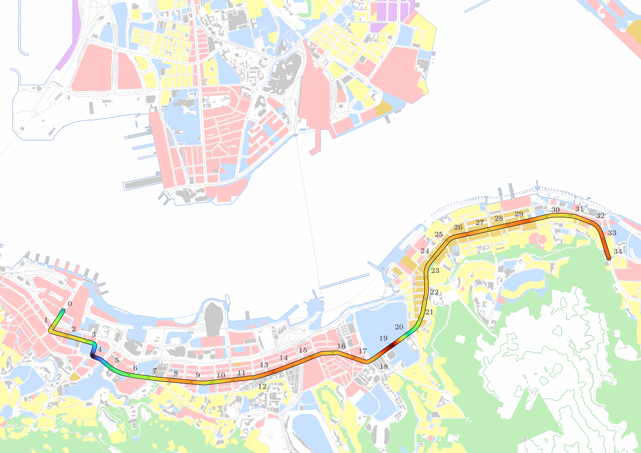
Legend
0
Roads
Mean number of storeys along transect
Shoreline
72
Buildings
Land use
Commercial use
Green Belt
Mixed commercial and residential use
Recreational use
Residential use
Industrial use
Wan Chai: proximity to HKCEC
Causeway Bay: good view overlooking Victoria Harbour
Victoria Park: recreational area
N
Close proximity to old residential area
500m

Slide 42
Plot of Mean Number of Storeys (with errors and outliers removed) and Building Height Restriction within a 200m Buffer, against Distance from PLVI, along the East Transect
Key
1
2
3
Mean number of storeys (with errors and outliers removed)
Building Height restriction for buildings within 20m buffer
Number of storeys
Commercial use
Mixed commercial and residential use
Residential use
Recreational use
Distance from PLVI (m)
Industrial use

Slide 43
Plot of Mean Number of Storeys (with errors and outliers removed) and Kernel Probability Density of Accessing Transportation Nodes, against the Distance from PLVI, along the East Transect
1
Key
2
Mean number of storeys (with errors and outliers removed)
Number of storeys
Kernel Probability Density (per m)
Kernel Probability Density of accessing a bus stop within 200m of the location
Kernel Probability Density of accessing one MTR exit within 500m
Distance from PLVI (m)

Slide 44
Plot of Mean Number of Storeys (with errors and outliers removed) and Median Household Monthly Income, against the Distance from PLVI, along the East Transect
1
Key
Mean number of storeys (with errors and outliers removed)
Number of storeys
Median Household Monthly Income (HKD)
Median household monthly income
Distance from PLVI (m)

Slide 45
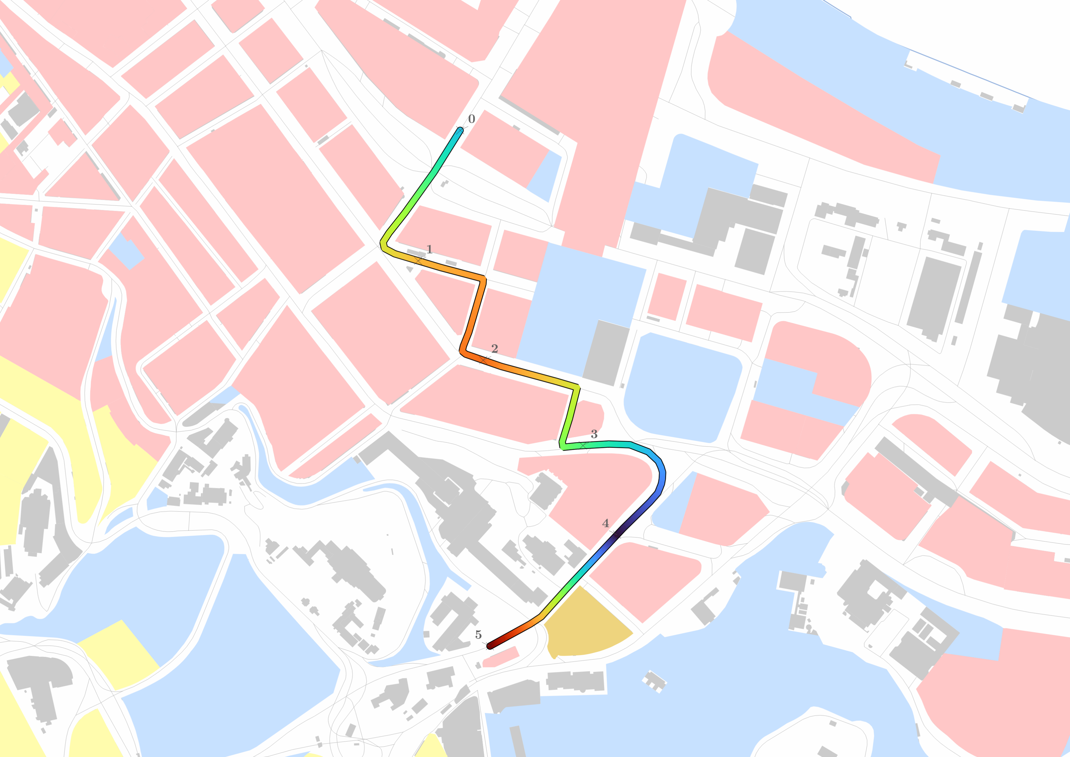
Legend
100m
22
Roads
N
Mean number of storeys along transect
Shoreline
58.5
Buildings
Land use
Commercial use
Green Belt
Mixed commercial and residential use
Recreational use
Residential use
Industrial use
Chater Garden: recreational area
Former French Mission building: historical monument

Slide 46
Plot of Mean Number of Storeys (with errors and outliers removed) and Building Height Restriction within a 200m Buffer, against Distance from PLVI, along the South Transect
Key
Mean number of storeys (with errors and outliers removed)
Building Height restriction for buildings within 20m buffer
Number of storeys
Commercial use
Mixed commercial and residential use
Residential use
Recreational use
Distance from PLVI (m)
Industrial use

Slide 47
Plot of Mean Number of Storeys (with errors and outliers removed) and Kernel Probability Density of Accessing Transportation Nodes, against the Distance from PLVI, along the South Transect
Key
Mean number of storeys (with errors and outliers removed)
Number of storeys
Kernel Probability Density (per m)
Kernel Probability Density of accessing a bus stop within 200m of the location
Kernel Probability Density of accessing one MTR exit within 500m
Distance from PLVI (m)

Slide 48
Plot of Mean Number of Storeys (with errors and outliers removed) and Median Household Monthly Income, against the Distance from PLVI, along the South Transect
Key
Mean number of storeys (with errors and outliers removed)
Number of storeys
Median Household Monthly Income (HKD)
Median household monthly income
Distance from PLVI (m)

Slide 49
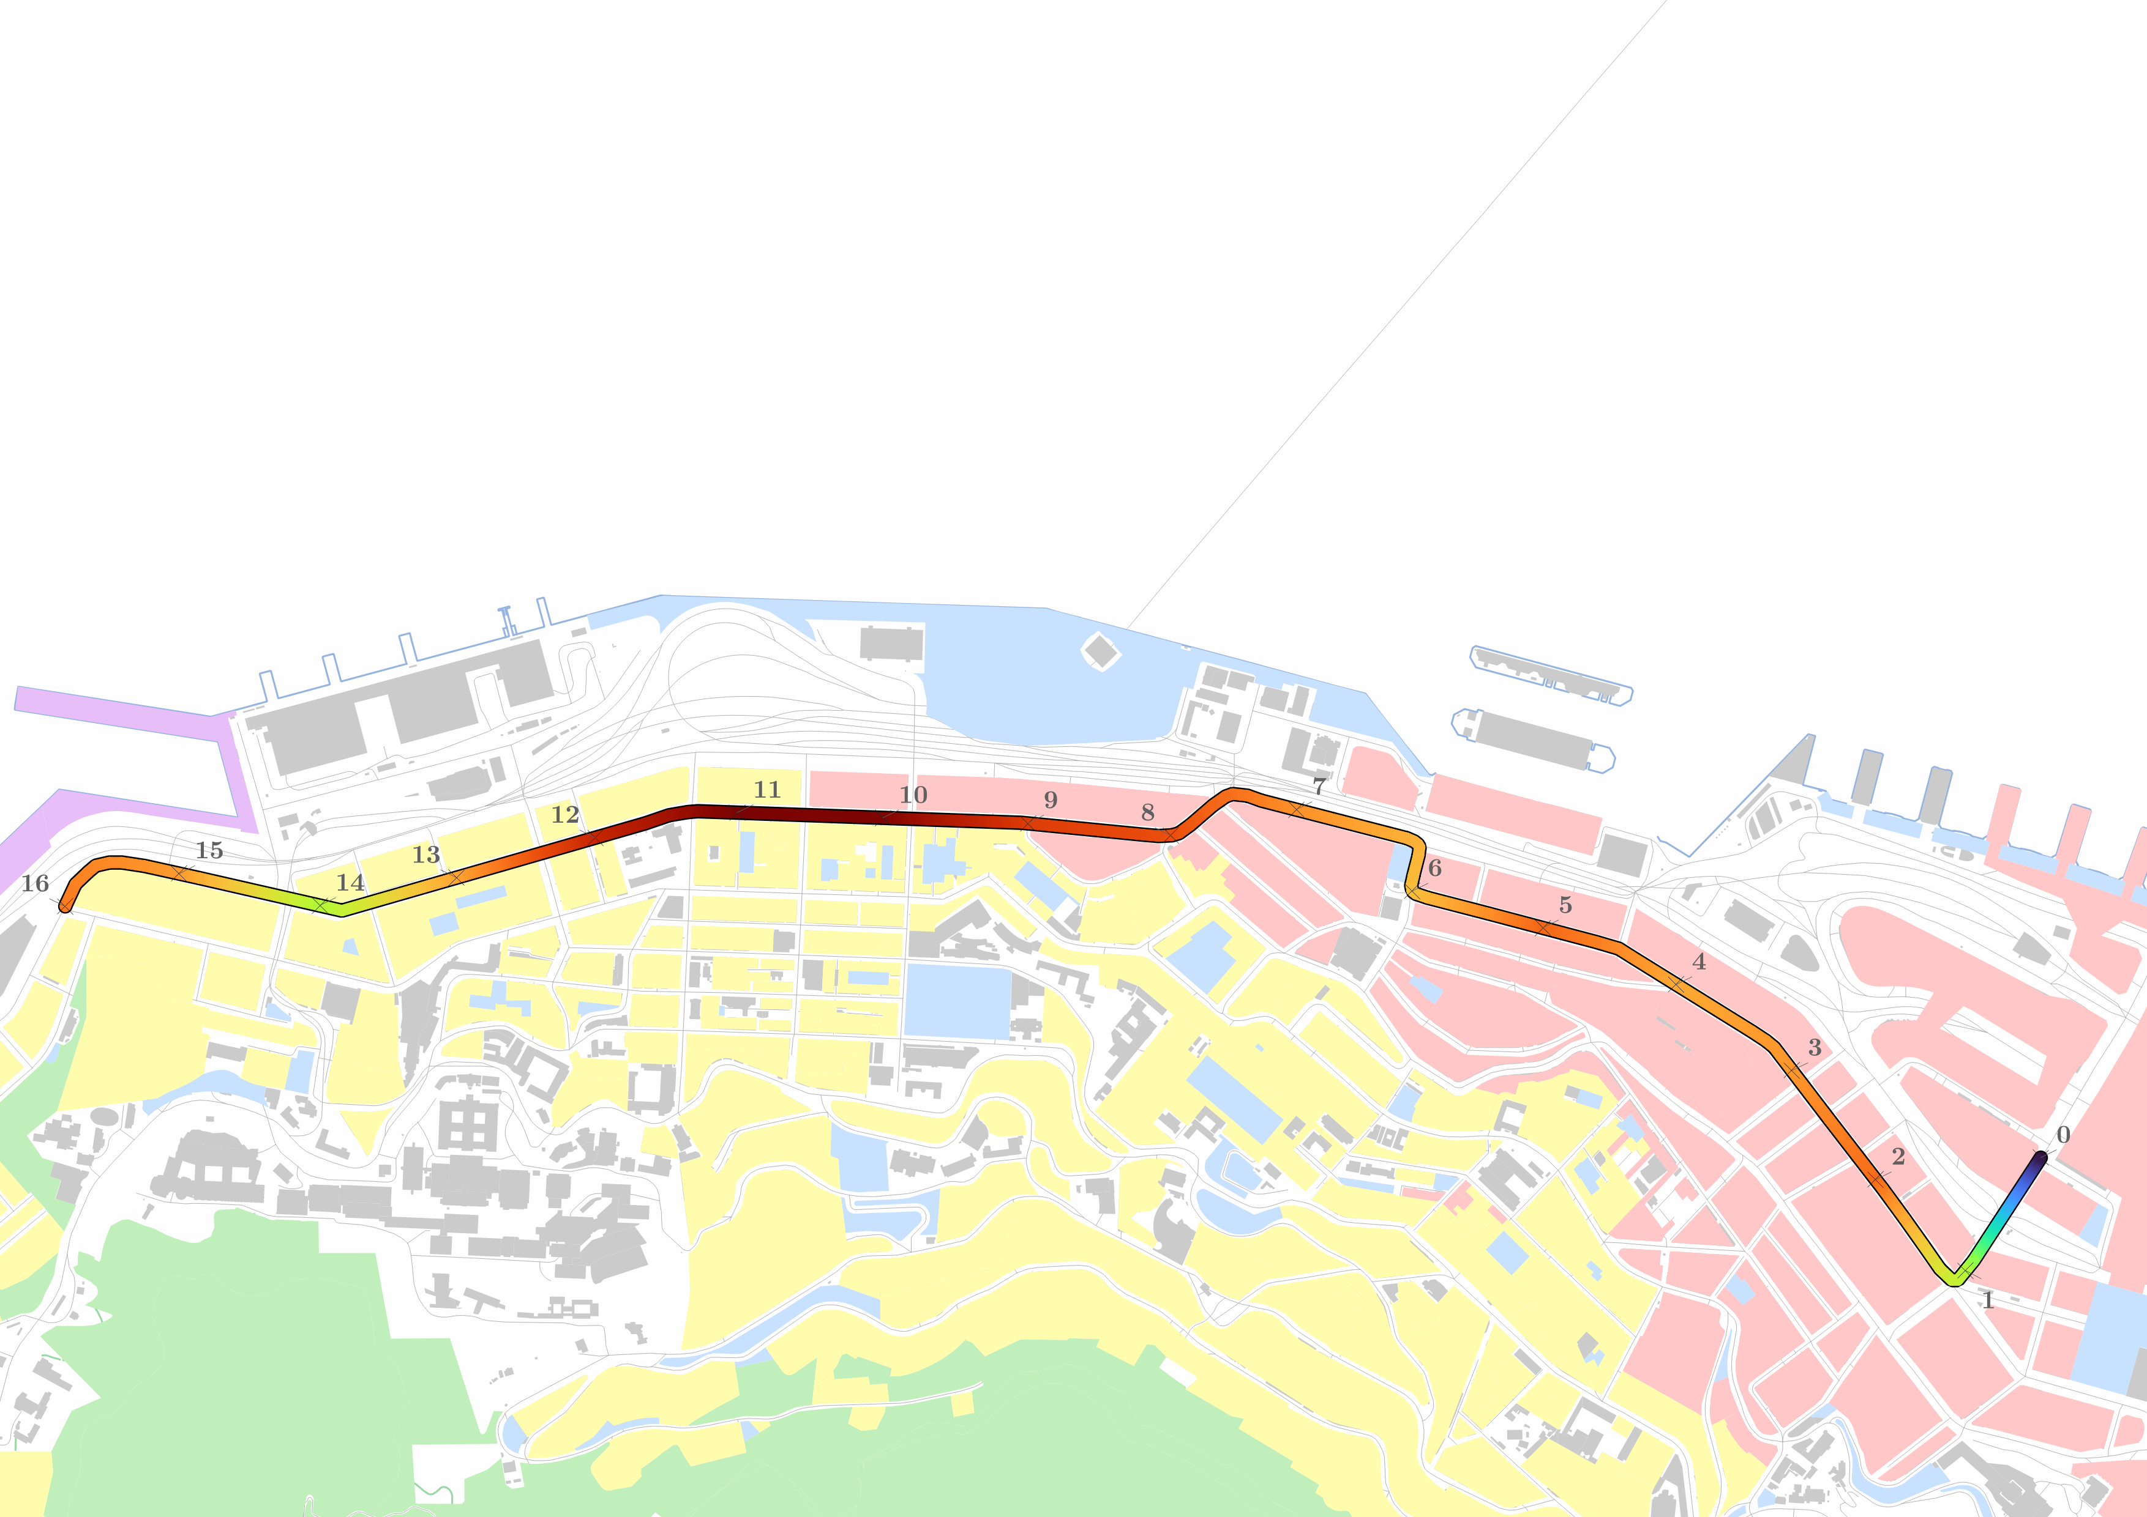
N
Legend
12.5
Roads
Mean number of storeys along transect
Shoreline
49
Buildings
Land use
Sai Ying Pun: old residential area
Commercial use
Green Belt
Shek Tong Tsui: close proximity to HKU campus
Mixed commercial and residential use
Recreational use
Residential use
Industrial use
200m
Size of Commercial Area Shrinks

Slide 50
Plot of Mean Number of Storeys (with errors and outliers removed) and Building Height Restriction within a 200m Buffer, against Distance from PLVI, along the West Transect
Key
Mean number of storeys (with errors and outliers removed)
1
2
Building Height restriction for buildings within 20m buffer
Number of storeys
Commercial use
Mixed commercial and residential use
Residential use
Recreational use
Distance from PLVI (m)
Industrial use

Slide 51
Plot of Mean Number of Storeys (with errors and outliers removed) and Kernel Probability Density of Accessing Transportation Nodes, against the Distance from PLVI, along the West Transect
Key
Mean number of storeys (with errors and outliers removed)
Number of storeys
Kernel Probability Density (per m)
Kernel Probability Density of accessing a bus stop within 200m of the location
Kernel Probability Density of accessing one MTR exit within 500m
Distance from PLVI (m)

Slide 52
Plot of Mean Number of Storeys (with errors and outliers removed) and Median Household Monthly Income, against the Distance from PLVI, along the West Transect
Key
Mean number of storeys (with errors and outliers removed)
Number of storeys
Median Household Monthly Income (HKD)
Median household monthly income
Distance from PLVI (m)

Slide 53
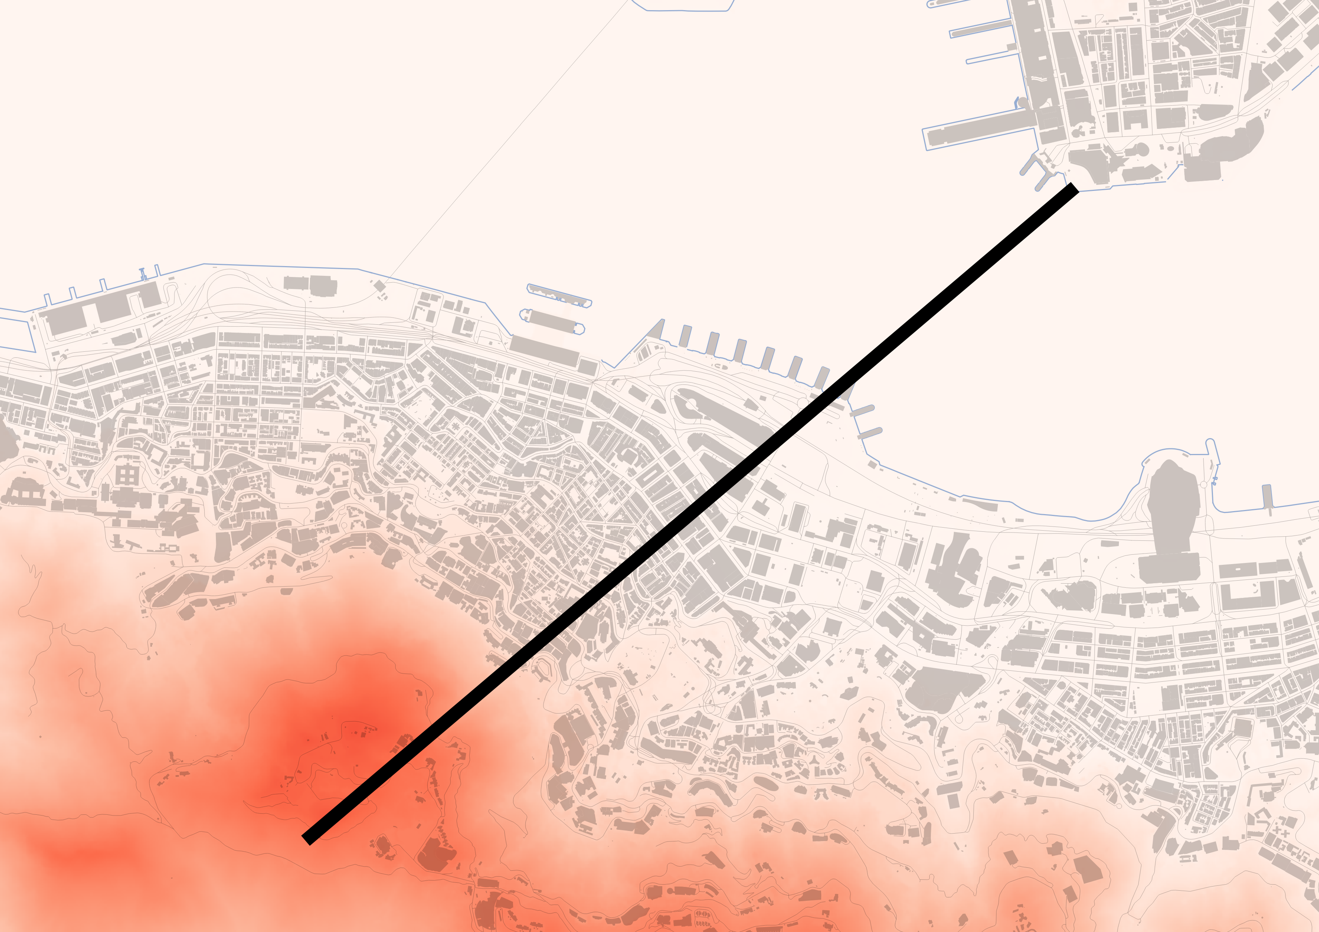
Victoria Peak Ridgeline
Legend
Location of transect (x-axis)
Buildings not to cross 80% of the height of ridgeline
Buildings
20%
Terrain
Water
0
Height of terrain
552
Height of terrain/building (m)
Tsim Sha Tsui Cultural Complex (VP2)
80%
832879, 814873
mPD
Victoria Harbour
Caine Rd
Connaught Rd Central
PLVI
835517, 817114
mPD
200m

Slide 54
N
Legend
12.5
Roads
Mean number of storeys along transect
Shoreline
49
Buildings
Land use
Sai Ying Pun: old residential area
Commercial use
Green Belt
Shek Tong Tsui: close proximity to HKU campus
Mixed commercial and residential use
Recreational use
Residential use
Industrial use
200m
Size of Commercial Area Shrinks

Slide 55
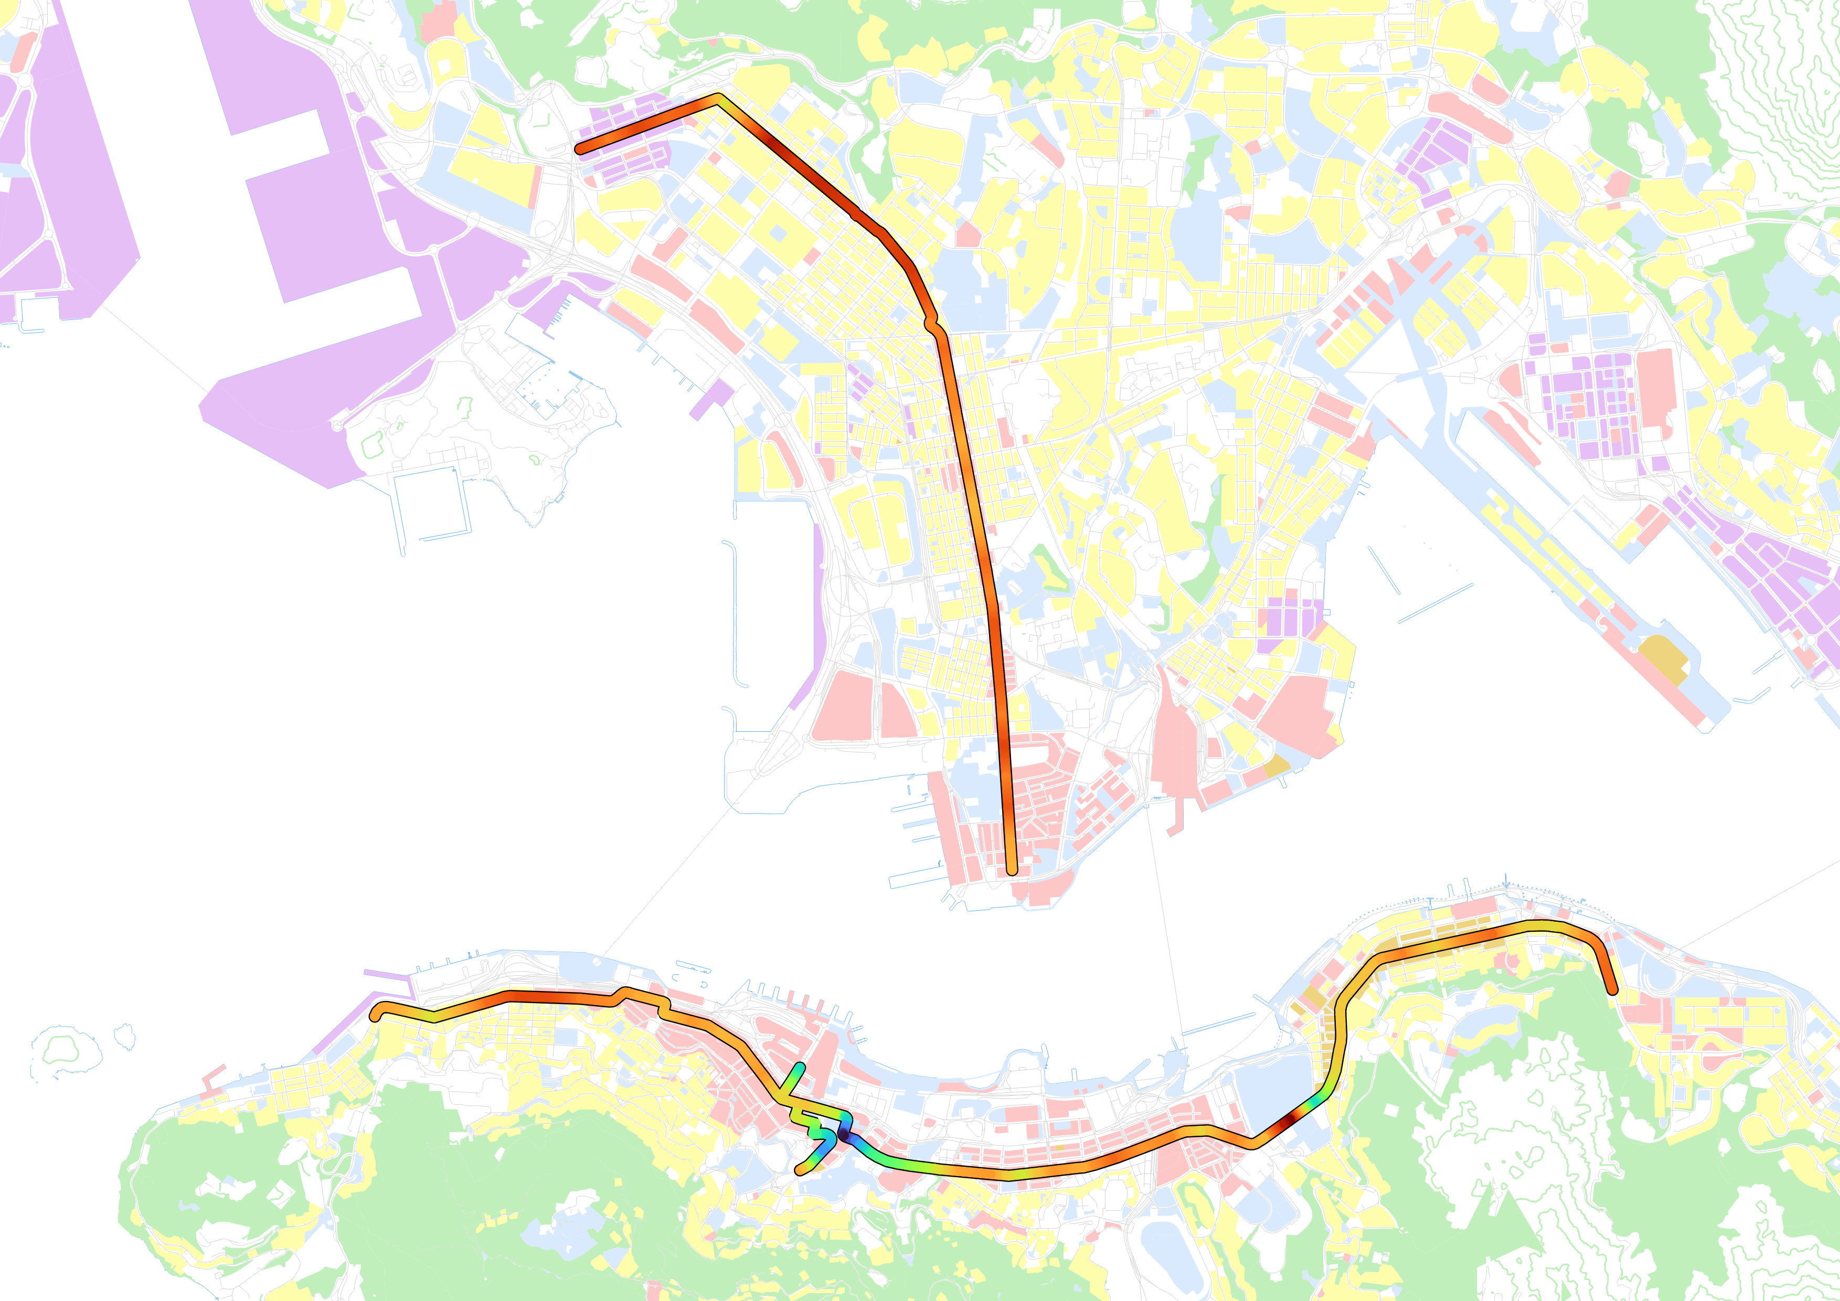
Legend
0
Roads
Mean number of storeys along transects
Shoreline
72
Buildings
Land use
Commercial use
Green Belt
Mixed commercial and residential use
Recreational use
Residential use
Industrial use
N
1km

Slide 56
Plot of Gross Unit Price of Residential Buildings against Building Height
Weak positive correlation between gross unit price and building height
Gross Unit Price (HKD/ft²)
Building Height (m)

Slide 57
Preservation of the Victoria Peak ridgeline
View overlooking the landscape increases land value despite low height
South
North
20%
Building height “distributed” due to height restriction
Steep gradient prevents urban sprawl in the Burgess Model
80%
PLVI
Victoria Harbor reduces buildable area
Beacon Hill

Slide 58
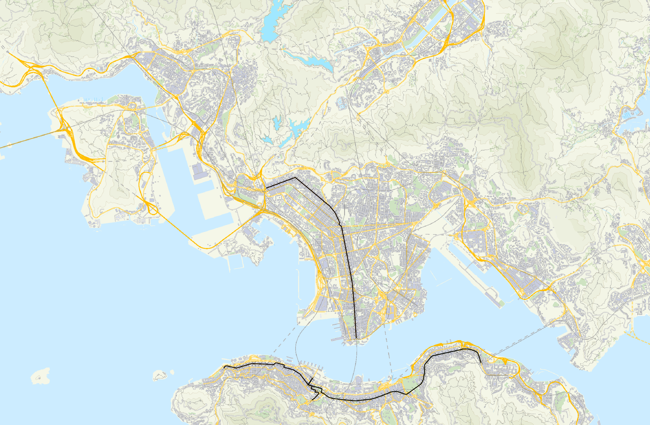
To Science Park
Ending at Tsuen Wan Station
To Ma On Shan
Ending at Wong Tai Sin
Ending at Kwun Tong
To Tsuen Kwan O
2km
N

Slide 59
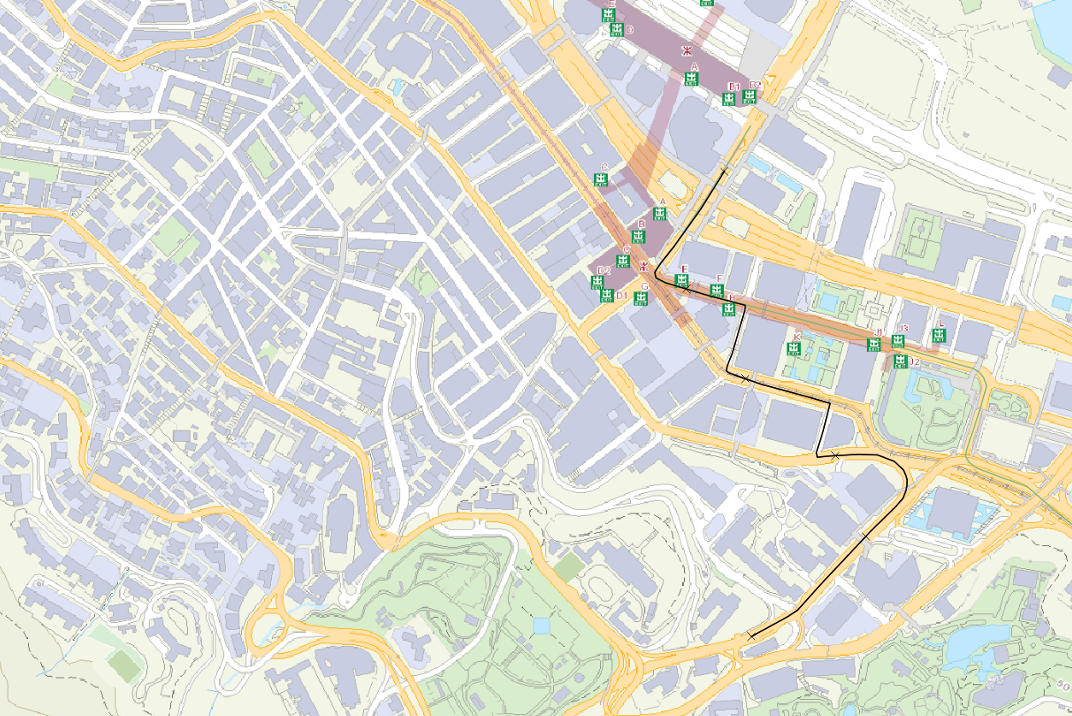
N
100m
Passes through the Central-Mid Levels Escalator

